Slide 1


Manoeuvring in a Seaway
(Module 8)
Dr Tristan Perez
Centre for Complex Dynamic Systems and Control (CDSC)
Prof. Thor I Fossen
Department of Engineering Cybernetics
One-day Tutorial, CAMS'07, Bol, Croatia

Slide 2
State of the art
Manoeuvres are generally performed in calm waters close to ports, but some times are also performed at sea in higher sea states.
This requires models which can handle manoeuvring and seakeeping.
The hydrodynamic problem is very complex, and we may still be a long time away from a solution.
The state of the art uses a combination of manoeuvring and seakeeping models via either
  Motion superposition
  Force superposition
One-day Tutorial, CAMS'07, Bol, Croatia

Slide 3
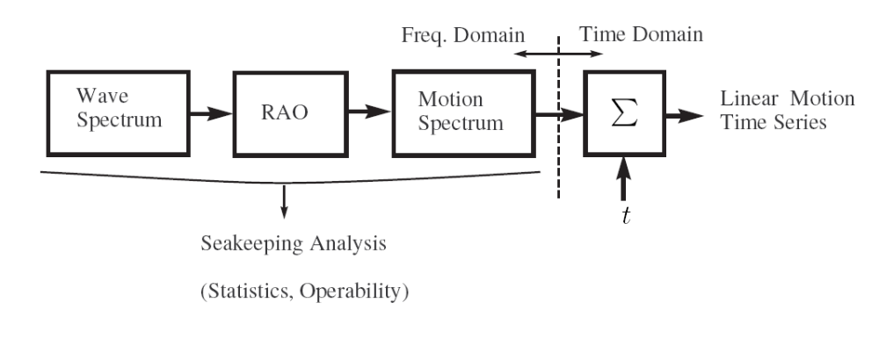
Frequency-domain seakeeping models
These models can be used to simulate wave-induced ship motion time series:
One-day Tutorial, CAMS'07, Bol, Croatia

Slide 4
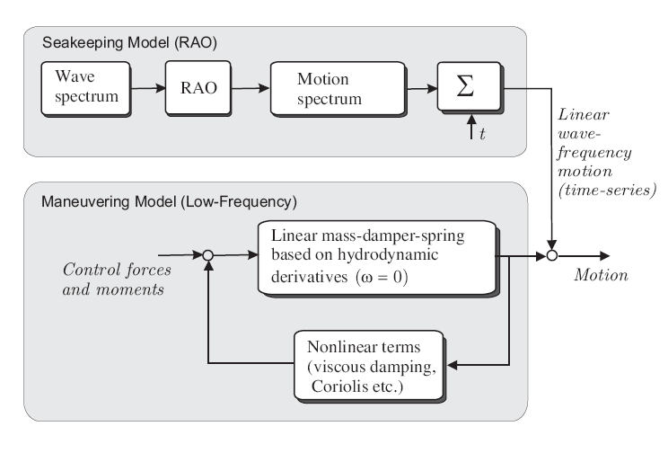
Motion superposition model
One-day Tutorial, CAMS'07, Bol, Croatia

Slide 5
Motion superposition model
Commonly used in control applications: autopilot, manoeuvring, formation control, rudder roll stabilisation.
The rationale behind this is that a wave filter rejects the 1st order wave induced motion, and no memory effects are then considered.
It can be a good assumption in lower sea states.
One-day Tutorial, CAMS'07, Bol, Croatia

Slide 6
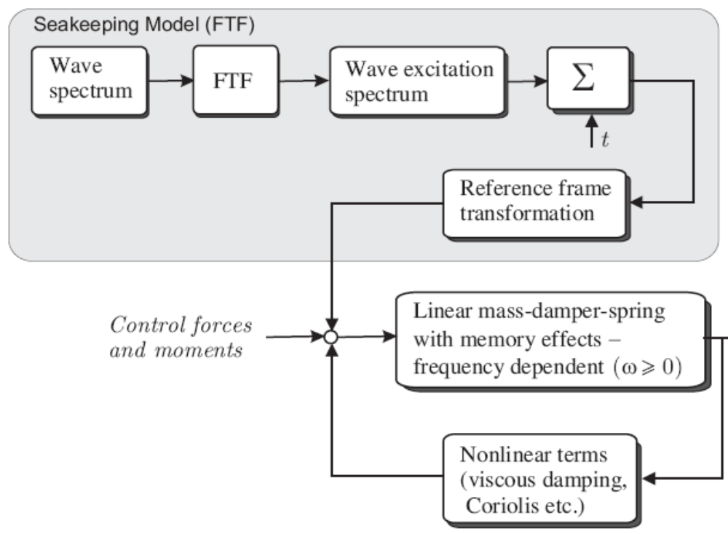

Force superposition model
Time-domain SK model + nonlinearities.
One-day Tutorial, CAMS'07, Bol, Croatia

Slide 7
Force superposition model
This is an attempt to obtain a unified model for manoeuvring in a seaway.
Fluid memory effects are incorporated, together with other non-linear effects characteristic of manoeuvring: lift-drag, cross-flow drag.
These models are based on the Cummins Equation expressed in terms of body-fixed coordinates, and the nonlinear effects are added.
The Centripetal-Coriollis terms still remain an issue.
This model is valid provided that the vessel manoeuvres slowly—because part of the model is based on a seakeeping model.
One-day Tutorial, CAMS'07, Bol, Croatia

Slide 8
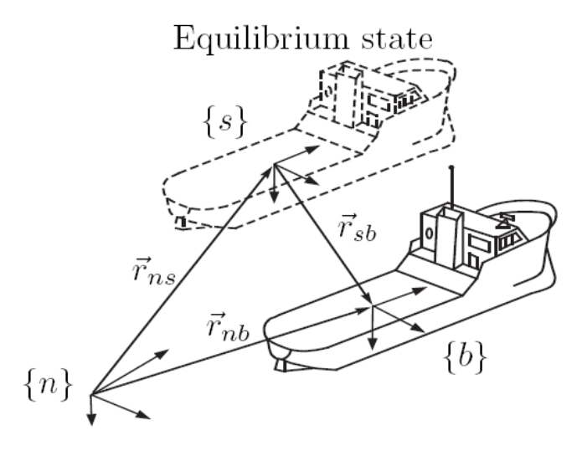
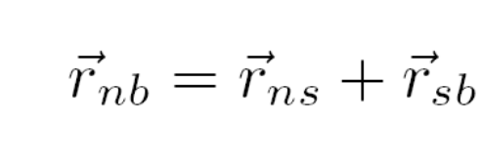
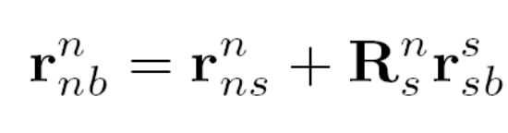
Kinematic transformations {s}-{b}
Following Perez & Fossen (2007)
In {n},
One-day Tutorial, CAMS'07, Bol, Croatia

Slide 9

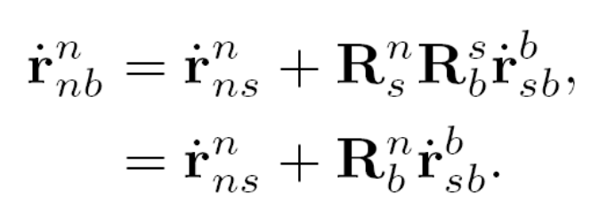
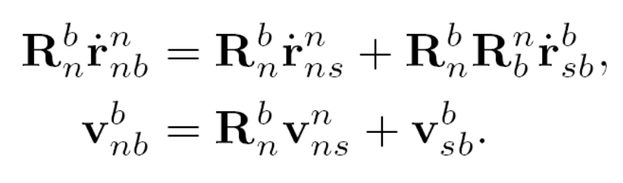
Kinematic transformations {s}-{b}
Taking the time-derivative
Taking it to {b},
One-day Tutorial, CAMS'07, Bol, Croatia

Slide 10
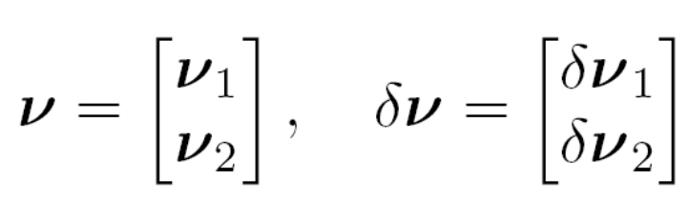
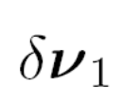





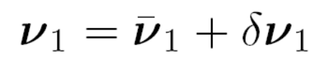
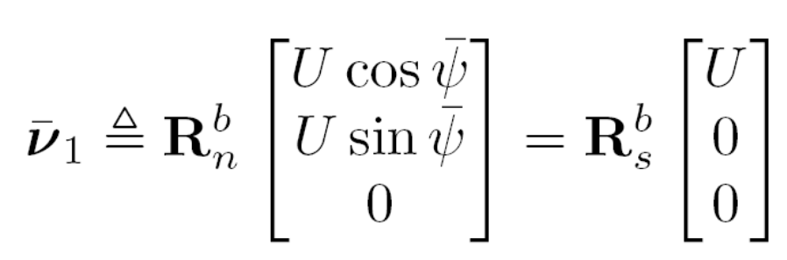
Kinematic transformations {s}-{b}
Let
Then
One-day Tutorial, CAMS'07, Bol, Croatia

Slide 11
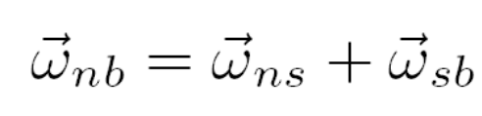

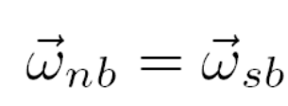
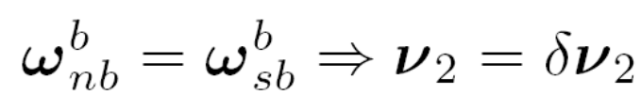
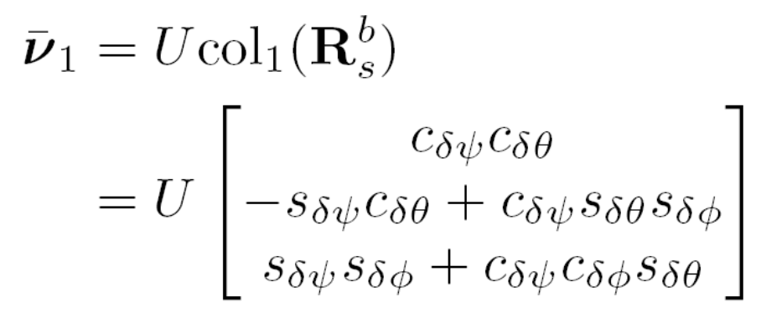
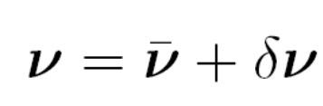

Kinematic transformations {s}-{b}
The angular velocities are related by
In {b}
Combining results
One-day Tutorial, CAMS'07, Bol, Croatia

Slide 12
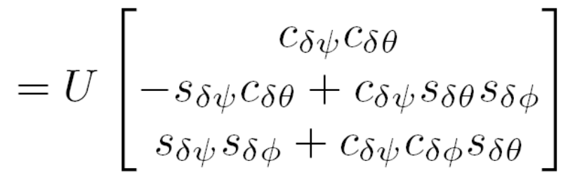
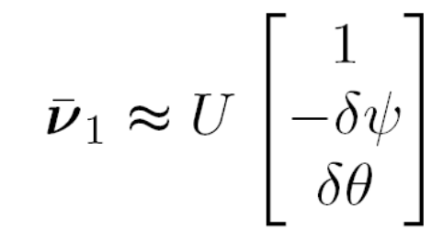
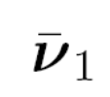

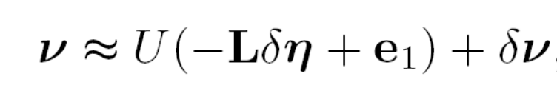
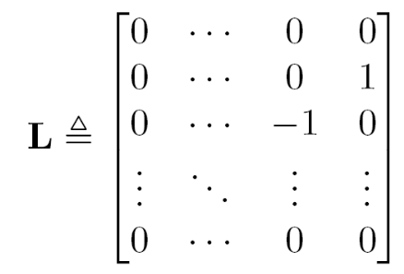
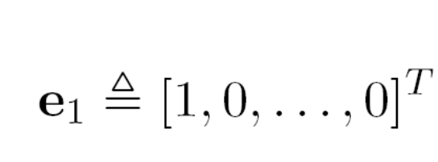
Kinematic transformations {s}-{b}
Taking small angle approximations
Hence, we obtain the sought transformation:
One-day Tutorial, CAMS'07, Bol, Croatia

Slide 13
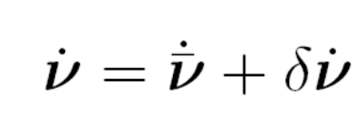
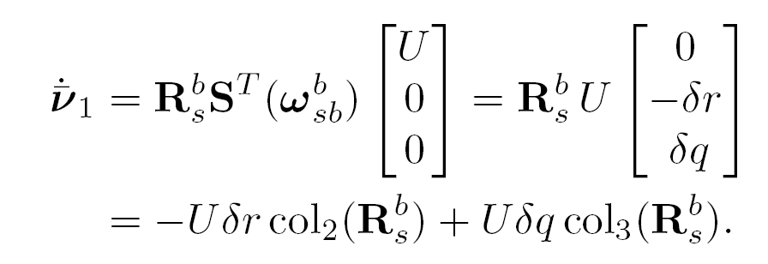
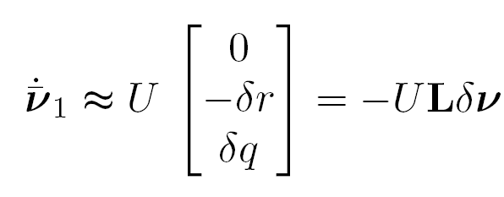

Kinematic transformations {s}-{b}
To relate the accelerations
where
Taking small angle approximations and considering only linear terms
Which is consistent with
One-day Tutorial, CAMS'07, Bol, Croatia

Slide 14
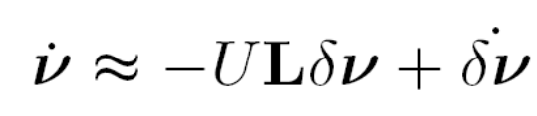
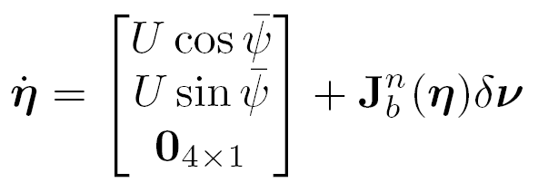
Kinematic transformations {s}-{b}
Velocities:
Accelerations:
Generalised Positions:
Now we can transform the Cummins Equation to {b}.
One-day Tutorial, CAMS'07, Bol, Croatia

Slide 15
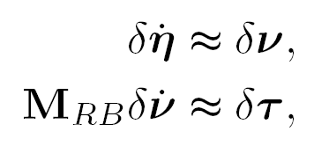
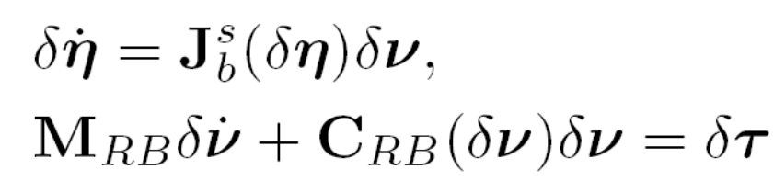
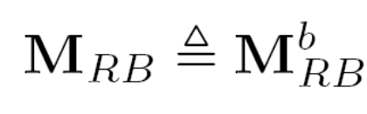
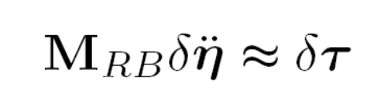
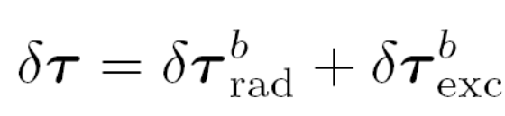
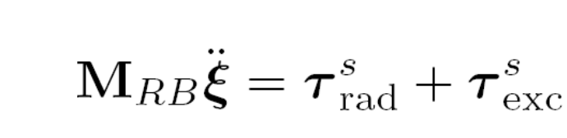
RB seakeeping Eq. of motion in {s}
Using the body-fixed perturbation coordinates we have
linear
Non-linear
One-day Tutorial, CAMS'07, Bol, Croatia

Slide 16
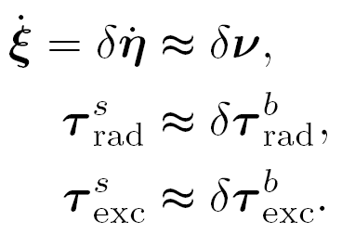
RB seakeeping Eq. of motion in {s}
We can think the linear-seakeeping equations of motion
as obtained from the body-fixed perturbation equations considering
NOTE: In the literature, it is commonly said that the seakeeping eq of motion is formulated in {s}, but this would imply that the inertias are time varying.
In our derivation, we formulate them in body-fixed coordinated and then ignore the nonlinear terms; this way, the inertias are constant because we are in body-fixed coordinates.
One-day Tutorial, CAMS'07, Bol, Croatia

Slide 17
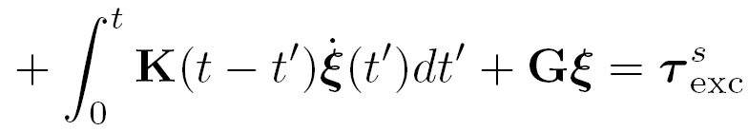


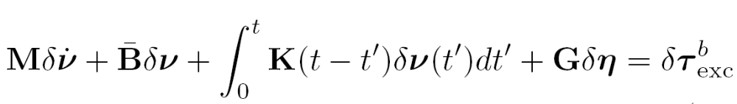

Cummins Equation in {b}
This model describes deviations from the equilibrium state in {b} within a linear framework and small angles.
One-day Tutorial, CAMS'07, Bol, Croatia

Slide 18
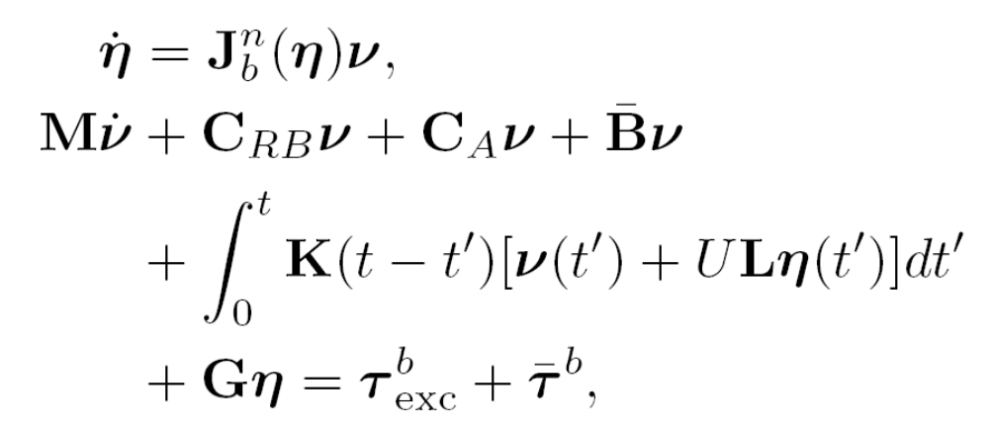
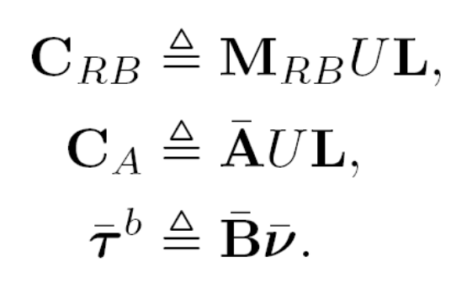
Cummins Equation in {b}
Expressed in terms of absolute (instead of incremental) variables:
NOTE: This equation valid provided the manoeuvring is very slow—because of the seakeeping assumptions under which the Cummins eq. was derived.
One-day Tutorial, CAMS'07, Bol, Croatia

Slide 19
Summary
The problem of manoeuvring in a seaway is still an open problem in ship theory.
A step towards a unified model for manoeuvring in a sea way consists of expressing Cummins Equation in {b}.
This is still a seakeeping model, which assumes a state of equilibrium from which the vessel is disturbed; and therefore, it may be use it for slow manoeuvring.
For slow manoeuvring, we can add Lift-Drag effects as a first approximation.
One-day Tutorial, CAMS'07, Bol, Croatia

Slide 20
References
Perez, T. and T. I. Fossen (2006) “Time-domain Models of Marine Surface Vessels Based on Seakeeping Computations.” 7th IFAC Conference on Manoeuvring and Control of Marine Vessels MCMC, Portugal, September.
Perez T., and T. I. Fossen (2007) “Kinematic Models for Seakeeping and Manoeuvring of Marine Vessels at Zero and Forward Speed.” To appear in Modeling Identification and Control (MIC), Norwegian Research Bulletin, Trondheim. MIC Vol 28, 2007, No 1.
One-day Tutorial, CAMS'07, Bol, Croatia

